Slide 1
Bank Loan Case Study
Presented by: Mannat Sandhu
https://drive.google.com/drive/folders/1x7XO4eyNlVKqjWCPfzCwkQB85faA7sAX?usp=drive_link

Slide 2
Introduction
This is a exploratory case study where we are provided with 3 datasets namely: columns description, previous application and application data.
The data provides applicants details and applications on which we use Exploratory Data Analysis (EDA) to analyze patterns in the data and ensure that capable applicants are not rejected.
Company faces two risks when applied for loan:
If the applicant can repay the loan but is not approved, the company loses business.
If the applicant cannot repay the loan and is approved, the company faces a financial loss.

Slide 3
When a customer applies for a loan, there are four possible outcomes:
Approved: The company has approved the loan application.
Cancelled: The customer cancelled the application during the approval process.
Refused: The company rejected the loan.
Unused Offer: The loan was approved but the customer did not use it.
Our goal in this project is to use EDA to understand how customer attributes and loan attributes influence the likelihood of defaults.

Slide 4

Tech-Stack Used
In this project I have used Microsoft excel 2010.

Slide 5
Approach
Download Data sets
Import data sets into MS Excel
Understanding the Datasets
Apply Data Handling Process
Prepared Data for Exploratory Data Analysis (EDA)

Slide 6
Data Analytics Tasks
Identify Missing Data and Deal with it Appropriately
Identify Outliers in the Dataset
Analyze Data Imbalance
Perform Univariate, Segmented Univariate, and Bivariate Analysis
Identify Top Correlations for Different Scenarios

Slide 7
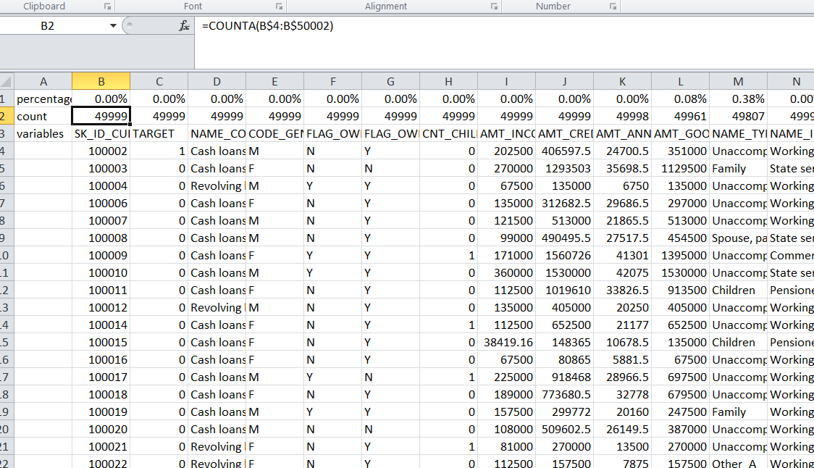
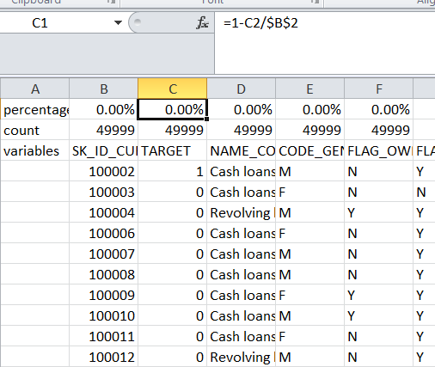
Identify Missing Data and Deal with it Appropriately
The first step in this task is to find the missing values in each column using counta and obtaining percentage for missing values in each column.

Slide 8
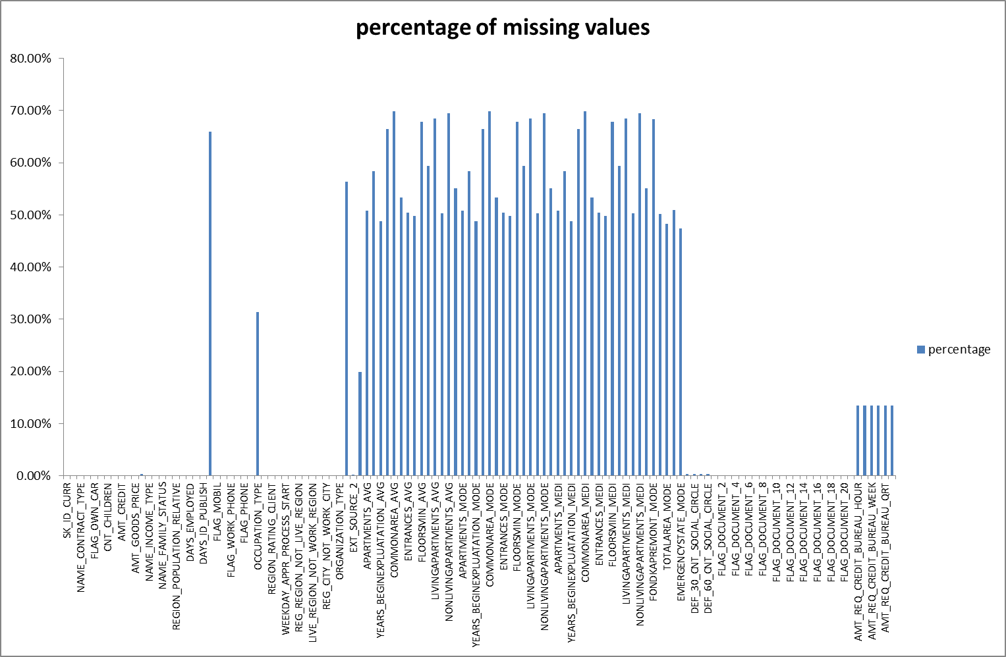

Slide 9
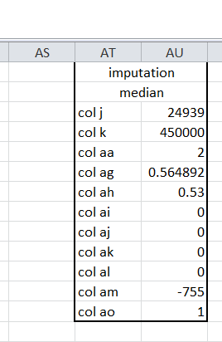
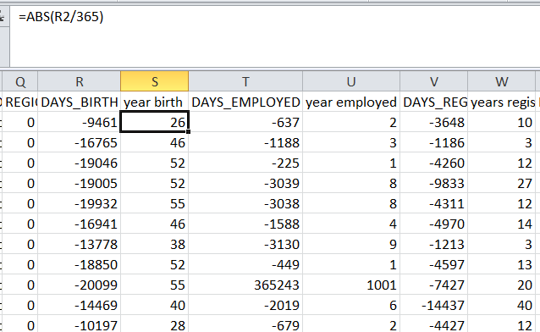
Identify Missing Data and Deal with it Appropriately
We will remove the columns in which the missing percentage is more than 30%. In all other columns we will impute the data with median and convert days columns to years using abs function.

Slide 10
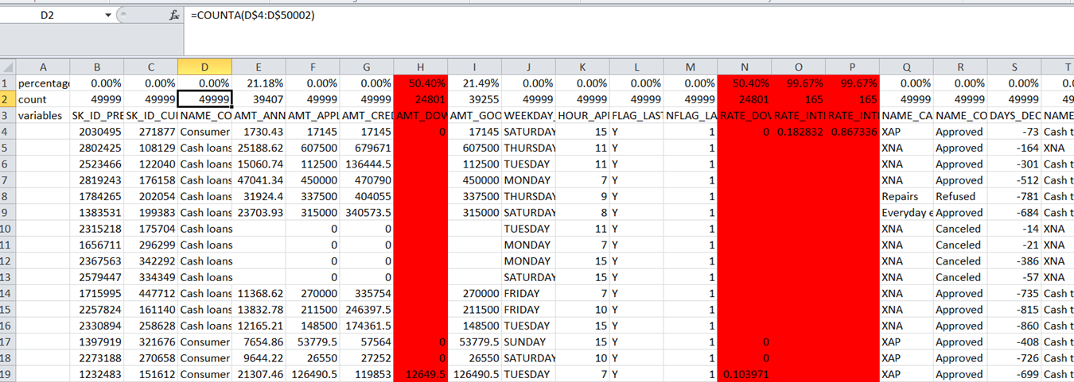
Previous application
We will follow the same process for previous application dataset and prepare the dataset for analysis.

Slide 11
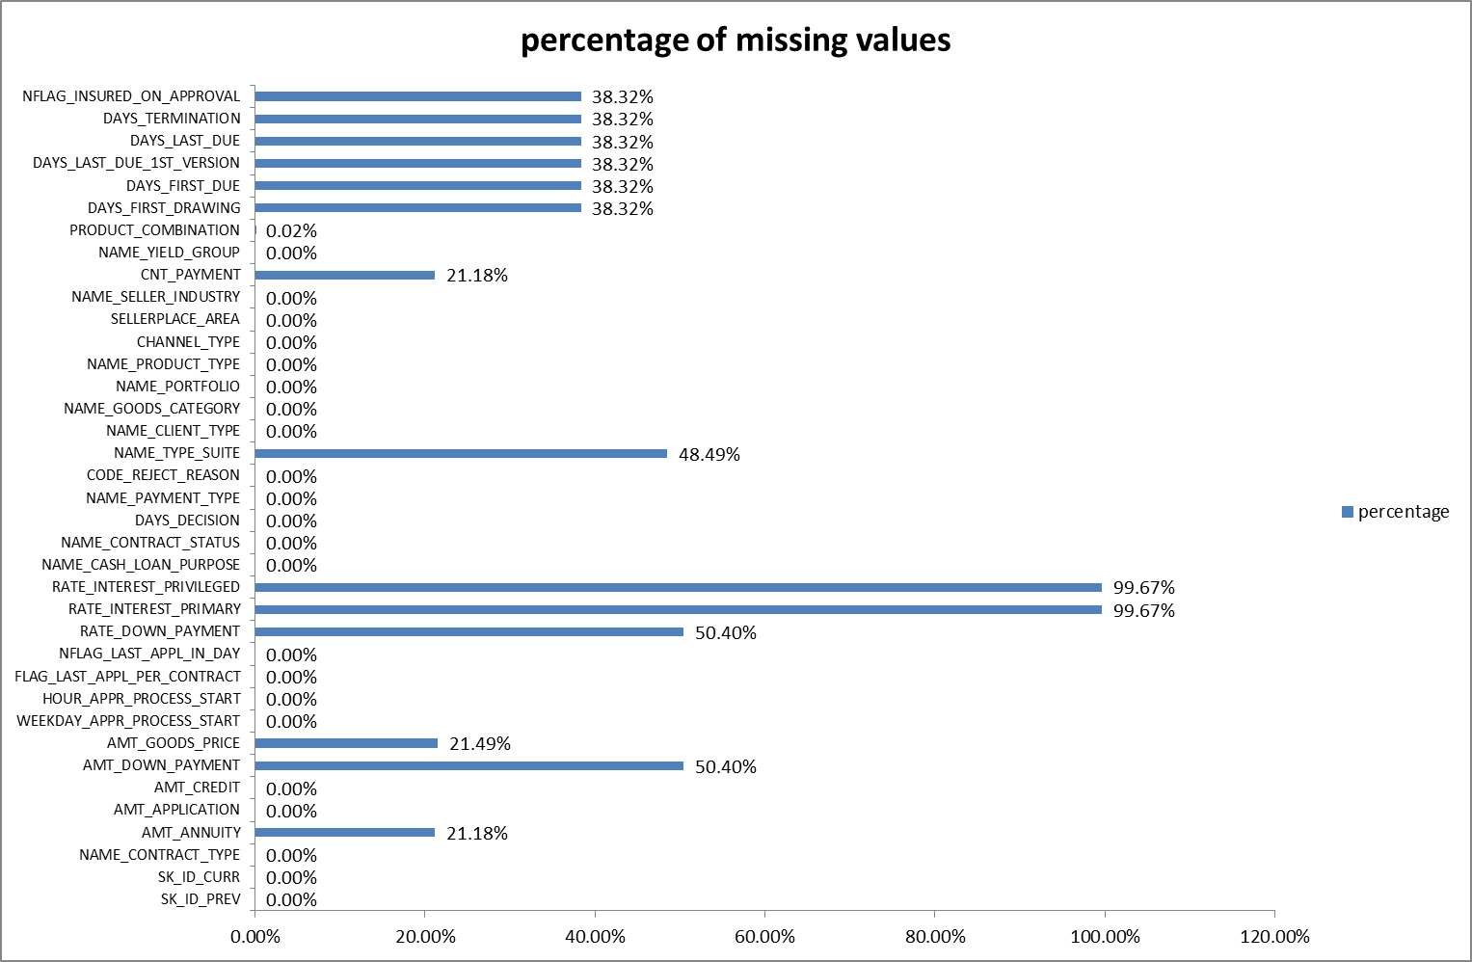

Slide 12
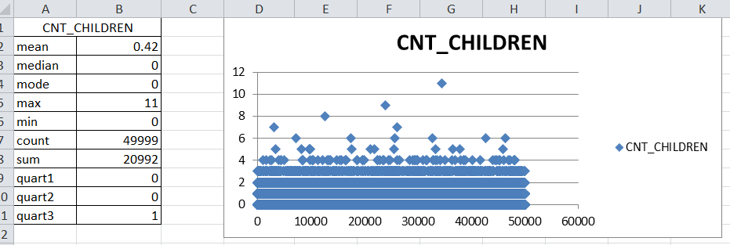
Identify Outliers in the Dataset
In this task we need to identify outliers in the dataset using statistical functions like mean, median, mode, max, min and quartiles on numerical columns.
And use scatter plot and box plot for pictorial outputs.

Slide 13
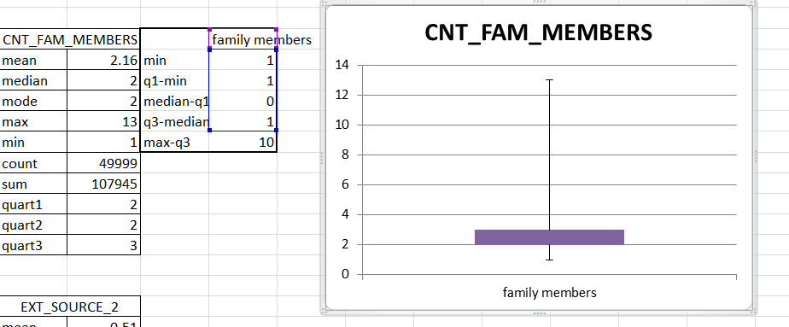

Slide 14
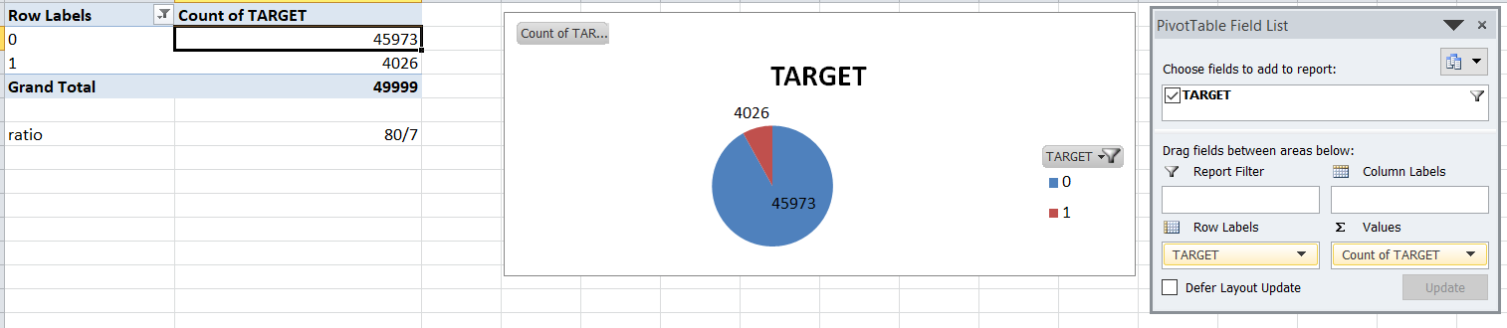
Analyze Data Imbalance
In this task we need to determine if there is data imbalance in the loan application dataset for building reliable models.
We will find data imbalance for catergorical columns using pivot tables and charts and calculate ratio for each.

Slide 15
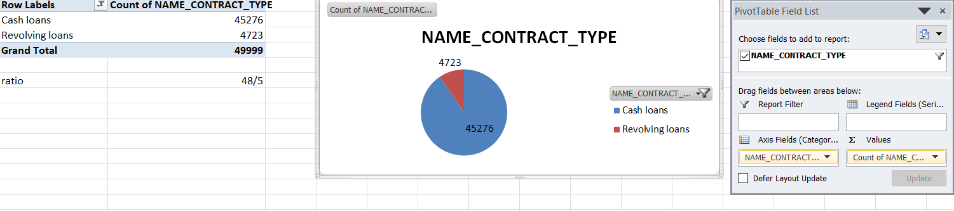
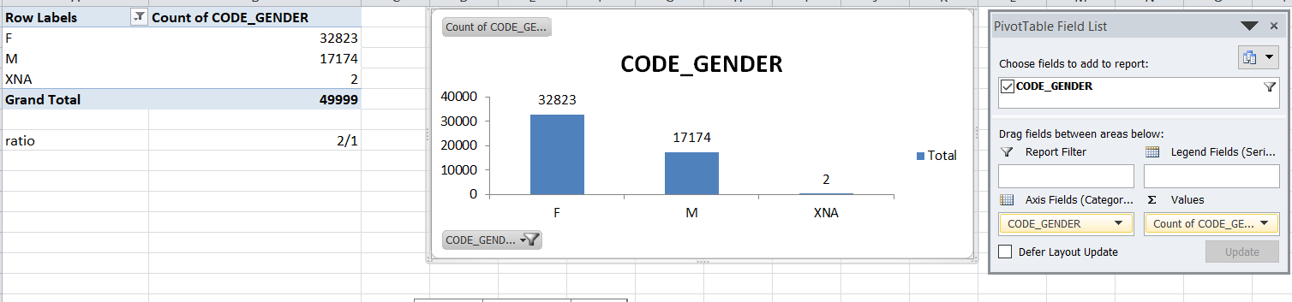

Slide 16
Perform Univariate, Segmented Univariate, and Bivariate Analysis
In this task we need to conduct various analyses on consumer and loan attributes to gain insights into the driving factors of loan default by performing Univariate, Segmented Univariate, and Bivariate Analysis on application data as well as previous application datasets.
For analysis we will first obtain descriptive analysis such as mean, median, std dev, etc using data analysis function in data menu.
Now we will use pivots for analysis and pictorial representations.

Slide 17
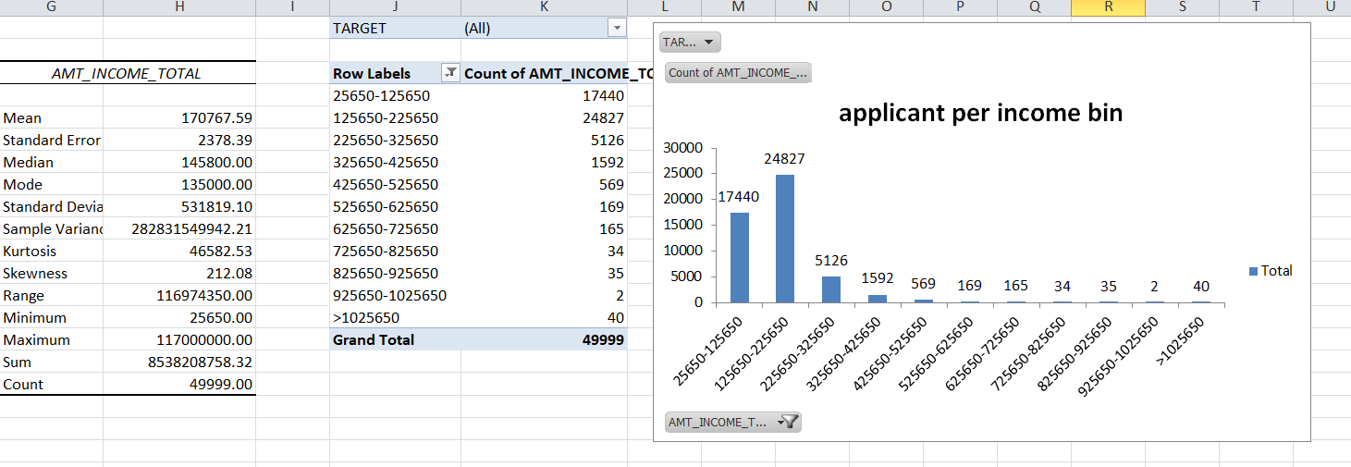
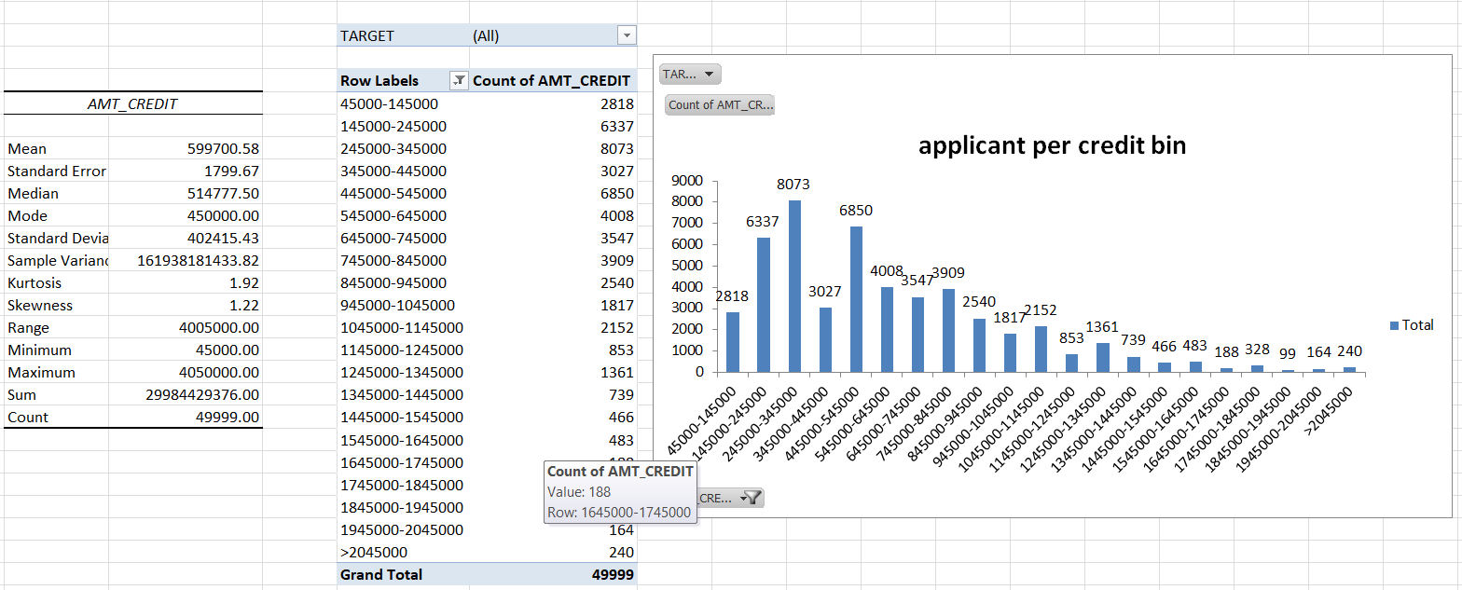
Univariate analysis for data application dataset:

Slide 18
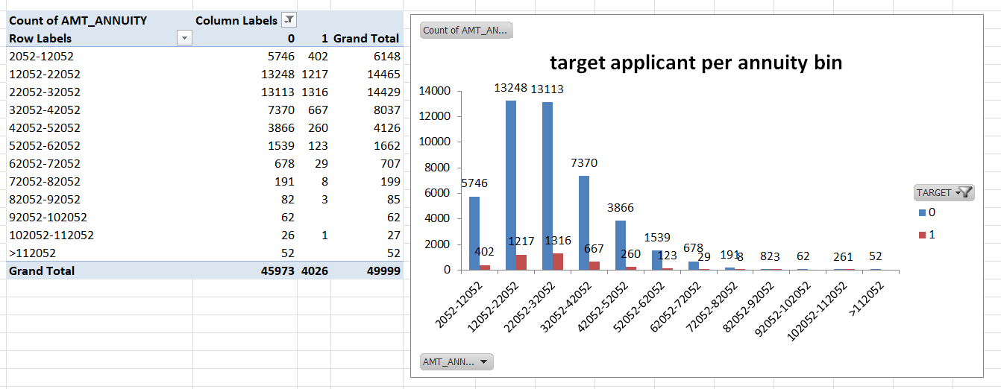
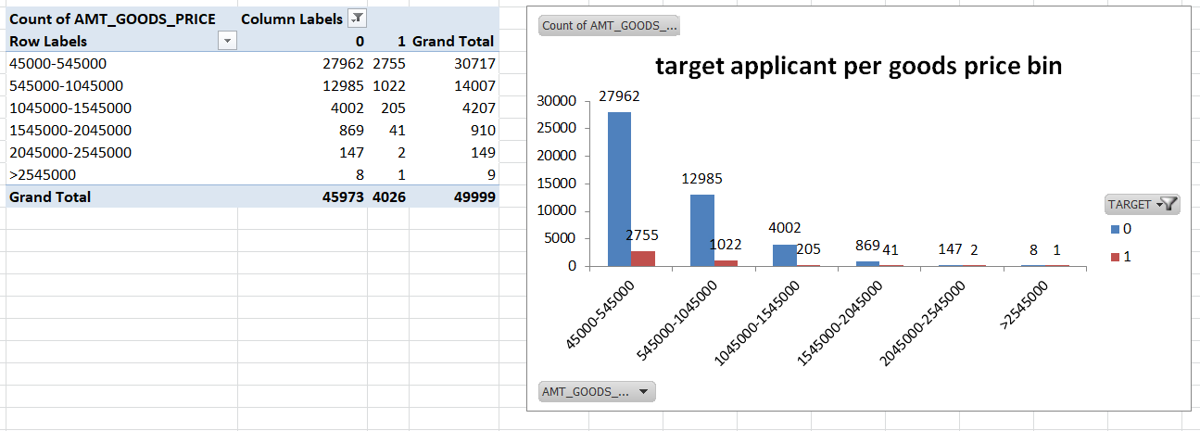
Segmented univariate analysis for application data:

Slide 19
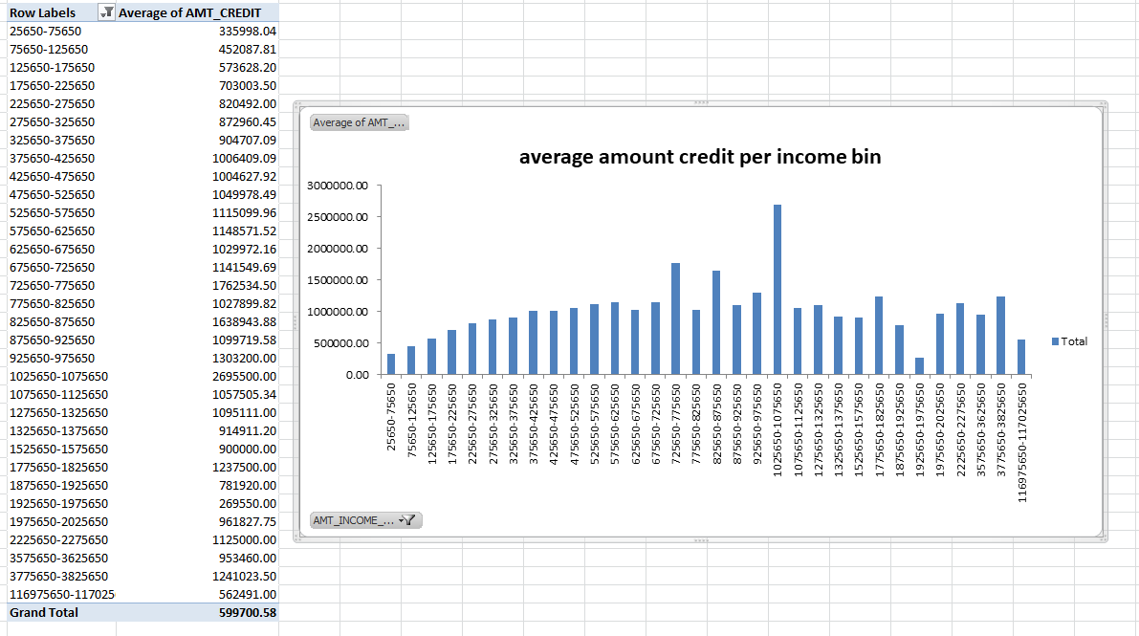
Bivariate analysis for application data:

Slide 20
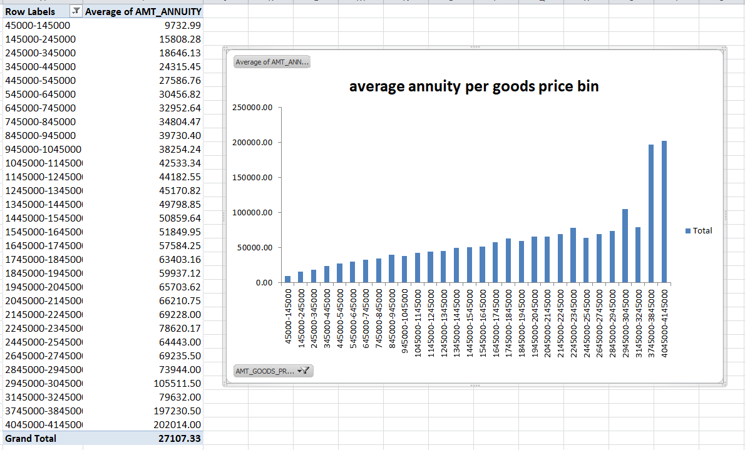

Slide 21
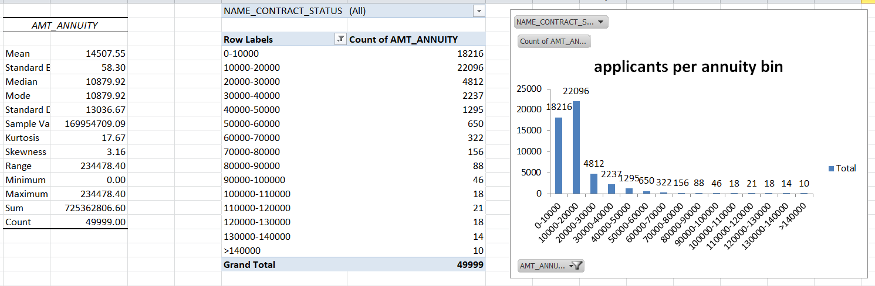
We will perform same with previous application dataset.
Univariate analysis:

Slide 22
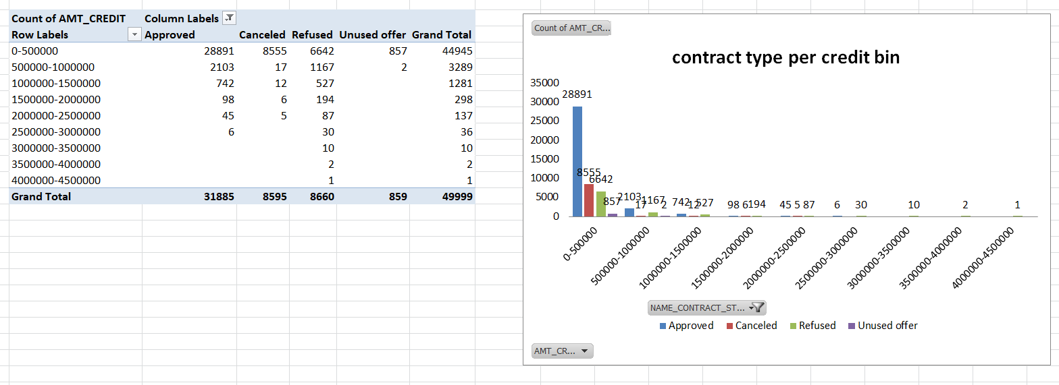
Segmented univariate analysis:

Slide 23
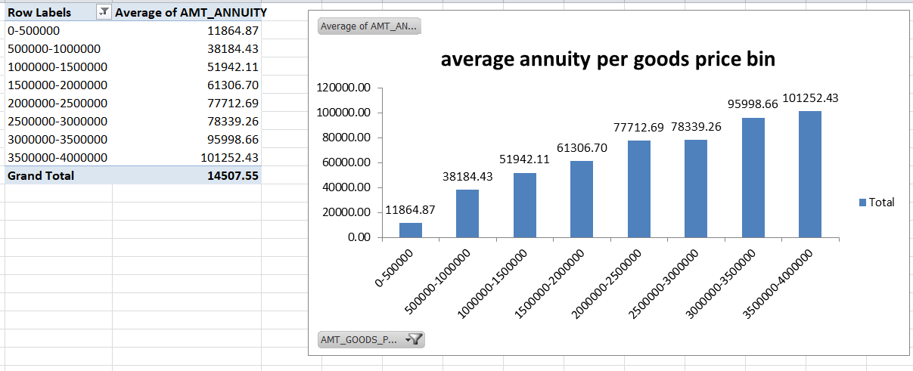
Bivariate analysis:

Slide 24
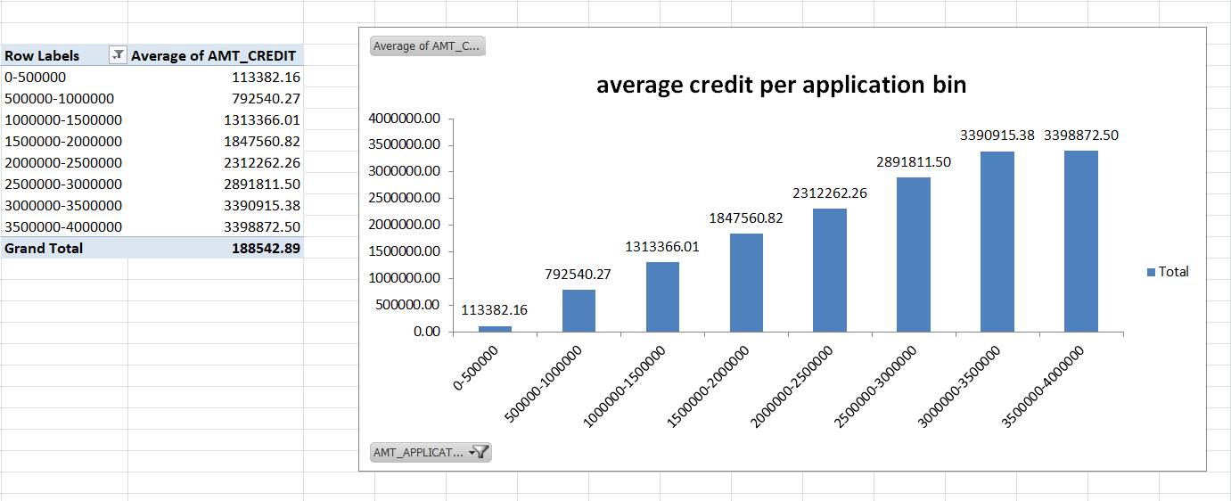

Slide 25
Identify Top Correlations for Different Scenarios
In this task we need to understanding the correlation between variables and the target variable.
For this we will filter out the data for target variables 1 and 0 using filter function.
Then we will apply correlation using data analysis function on each target variables with respect to numerical columns.

Slide 26
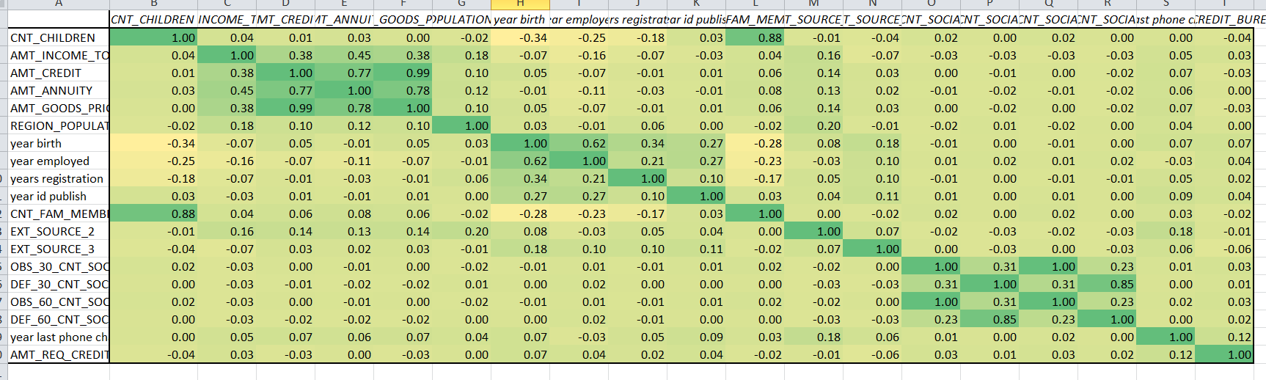
Target 0:

Slide 27
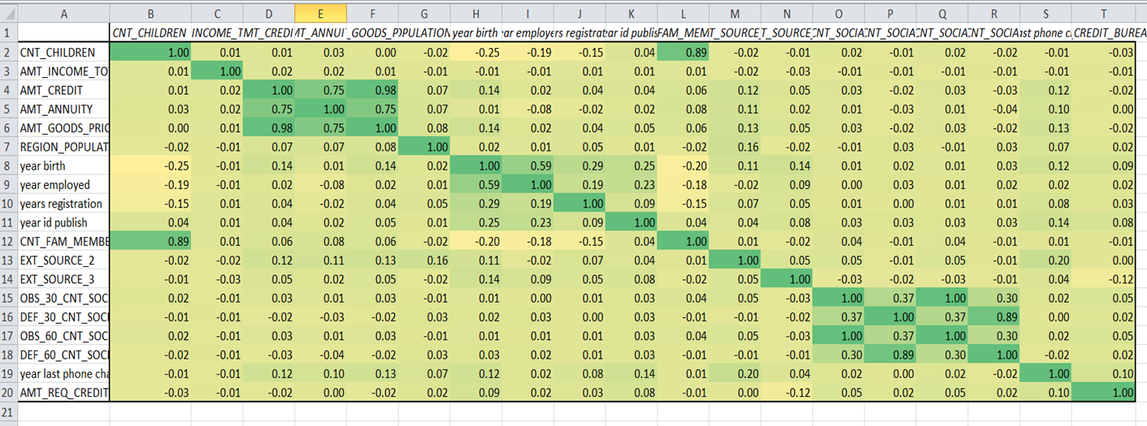
Target 1:

Slide 28
Results
From these analysis we can interpret that:
Outliers: the columns such as cnt_children, amt_income_total, years employed, etc with high values of outliers such as 11 children, income of 117000000, 1000 years of work experience, etc need to be reviewed.
Data imbalance: through this we can analyse the difference between the categories of a column. This gives the ratio of imbalance in categorical data such as gender, loan type, educational qualification, etc. which is crucial for building business models and understanding the targets.

Slide 29
Univariate, Segmented Univariate, and Bivariate Analysis: these analysis helps in understanding the high demand categories, potential demands of target variables and comparison between 2 variables such as amt_income_total and amt_credit which helps in defining the risks of loan defaults.
Correlations: these analysis defined the relationship between 2 variables which helps in understanding possible outcomes. The values of positive 1 indicates linear relationships between variables whereas negative 1 indicates inverse relationship. The value of 0 indicates no linear relationship.

Slide 30
Thank you

